Slide 1





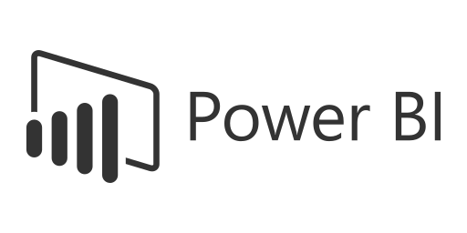


Project on Supply Chain Analytics
The Supply Chain Analytics Dashboard is designed to provide comprehensive visibility into critical supply chain operations, enabling stakeholders—including logistics managers, procurement teams, and executives—to make data-driven decisions. The dashboard tracks key performance indicators (KPIs) such as Order Fulfilment Rate, Inventory Turnover, Delivery Lead Time, and Supplier Performance, along with advanced analytics like Demand Forecasting, Cost-to-Serve Analysis, and Warehouse Efficiency Metrics
Mahendra Singh

Slide 2










PRESENTATION TOOLS
Project Steps for Supply Chain Data Analytics
Step-by-Step Workflow for Capstone Project
Data Preparation (Excel Dashboard)
SQL Integration (Database Setup)
BI Tool Connection (Data Modeling)
Dashboard Development
Quality Assurance (QA & Validation)
Utilize the provided Excel data to create an initial dashboard.
Perform basic data cleaning and transformation.
Identify key metrics (KPIs) and define data visualization requirements.
Load the cleaned Excel files into a SQL database under a well-structured schema.
Normalize the data to maintain integrity and avoid redundancy.
Establish primary and foreign key relationships to ensure referential integrity.
Connect the SQL database to Tableau and Power BI.
Build a comprehensive data model with necessary joins and relationships.
Optimize the model for performance by indexing and aggregating data where required.
Design interactive dashboards in Tableau and Power BI.
Ensure a user-friendly interface with filters, drill-throughs, and tooltips.
Incorporate advanced analytics, such as trend analysis and forecasting.
Compare database records with dashboard visuals to ensure data accuracy.
Perform end-to-end testing of calculations and relationships.
Validate against business requirements and make necessary improvements.

Slide 3



Structure the final presentation in PPT format, following a logical order
Report Preparation and final Submission
0
Final Presentation & Report Preparation
Group Details – Team members and roles.
Project Summary – Brief overview of objectives and impact.
KPI List – Key performance indicators and their business relevance.
Excel Dashboard – Initial findings and data trends.
Tableau Dashboard – Interactive visualizations and insights.
Power BI Dashboard – Advanced analytics and performance tracking.
SQL Query Image – Schema and queries used for data transformation.
Key Takeaways – Business insights, challenges, and future recommendations

Slide 4





Supply Chain Analytics Project
Project Participant Guidelines
Empowering Communication through Data Analytics
Attendance
Team Contribution Monitoring
Active Participation Requirement
Attendance is mandatory for all participants.
Missing more than two meetings will result in your removal from the project.
All team members must actively contribute to the project.
If any team member is not contributing, it is mandatory to inform the management regularly via call, WhatsApp, email, or during weekly review meetings
Merely attending meetings without making active contributions will lead to removal from the project.
Active involvement with your group is essential for continued participation.
Tool-Specific Contributions
Weekly Review Presentations
Meeting Attendance Name
As participants in the Data Analyst/Business Analyst track, you are required to contribute to all key tools, including:
Excel, Tableau, SQL, Power BI,
PPT Presentations
Failure to contribute to even a single tool may result in your removal from the project.
Each group must present their project progress during weekly review meetings.
Consistent updates and well-prepared presentations are expected from all teams.
You must join all meetings using the same name you registered with at Excelr.
Failure to inform us about this change will result in your attendance being marked as absent.

Slide 5







TEAM OVERVIEW
Key Focus Areas for the Project Team
As we continue working on our project, I would like to highlight a few key areas that we should focus on to ensure efficiency and success
Active Contribution
Sharing Insights
01
Each team member should actively participate and engage with the team.
05
Provide your insights and suggestions to improve the overall work quality.
Timely Completion of Tasks
Collaboration Over Competition
02
Ensure that all assigned work is completed within the given deadlines.
06
Work as a team, focusing on collective success rather than individual achievements.
Clear Communication
07
Active Listening
03
This platform utilizes AI technology to quickly transform ideas into captivating presentations.
07
The founders envisioned a solution to save time while enhancing the quality of presentations.
Daily Team Connectivity
08
Recognizing Contributions
07
Acknowledge and appreciate the efforts of your teammates to boost motivation and morale.
04
Stay connected with the team on a daily basis to discuss progress and address any challenges.

Slide 6
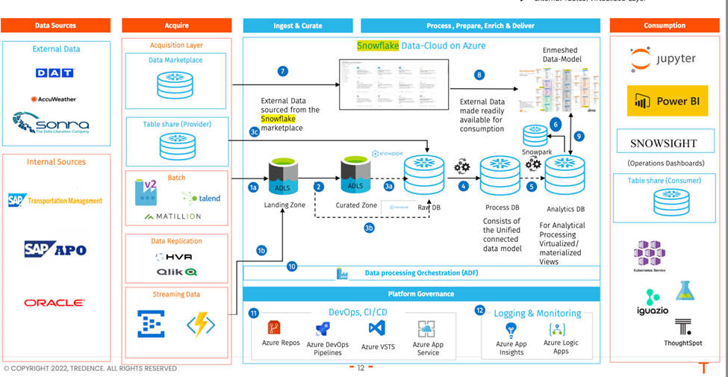


Sample: Project Architecture

Slide 7
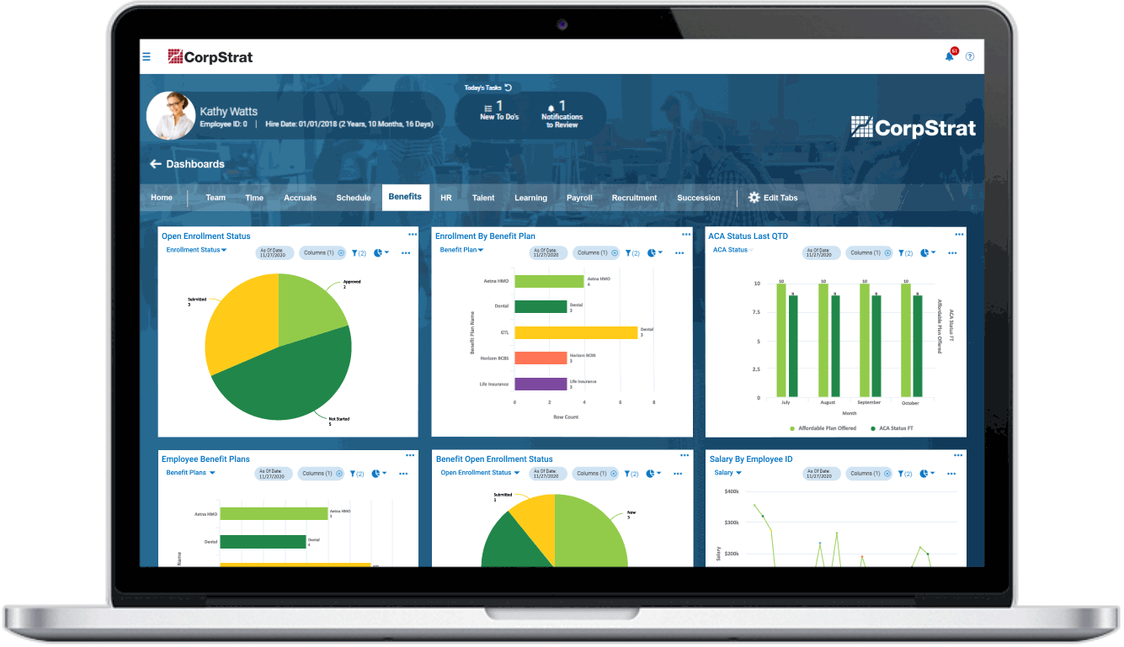
KEY DECISIONS
Key Performance Indicators
Consider adding additional KPIs to the dashboard that are also important for the business.
Inventory Dashboard KPI
Total Sales (MTD, QTD, YTD):
Tracks the total sales achieved within different time periods:
MTD (Month-to-Date): Sales from the start of the current month up to the current date.
QTD (Quarter-to-Date): Sales from the start of the current quarter up to the current date.
YTD (Year-to-Date): Sales from the start of the year up to the current date.
Product Wise Sales:
Monitors sales figures segmented by individual products or product categories to identify top-performing and underperforming products.
Sales Growth:
Measures the percentage increase or decrease in sales compared to a previous period (e.g., month-over-month or year-over-year growth).
Daily Sales Trend:
Analyzes sales performance on a daily basis to spot patterns, peaks, or dips in sales activity.
State Wise Sales:
Provides sales data broken down by states or geographical areas to identify regional performance trends.
Top 5 Store Wise Sales:
Highlights the five stores with the highest sales, helping to identify star performers and best practices.
Region Wise Sales:
Tracks sales across various regions, which may include multiple states or territories, for macro-level performance insights.
Total Inventory:
Shows the total stock quantity available in hand across all warehouses or locations.
Inventory Value:
Represents the monetary value of the current inventory based on cost or market value.
Overstock, Out-of-stock, Under-stock:
Categorizes inventory health into three states:
In-stock: Inventory in hand is equal to or greater than the minimum stock quantity required.
Out-of-stock: Inventory in hand is less than 0 (no stock available).
Under-stock: Inventory in hand is less than the desired stock quantity but not entirely out of stock.
Purchase Method Wise Sales:
Breaks down sales based on the method of purchase, such as online, in-store, cash, or credit card.

Slide 8

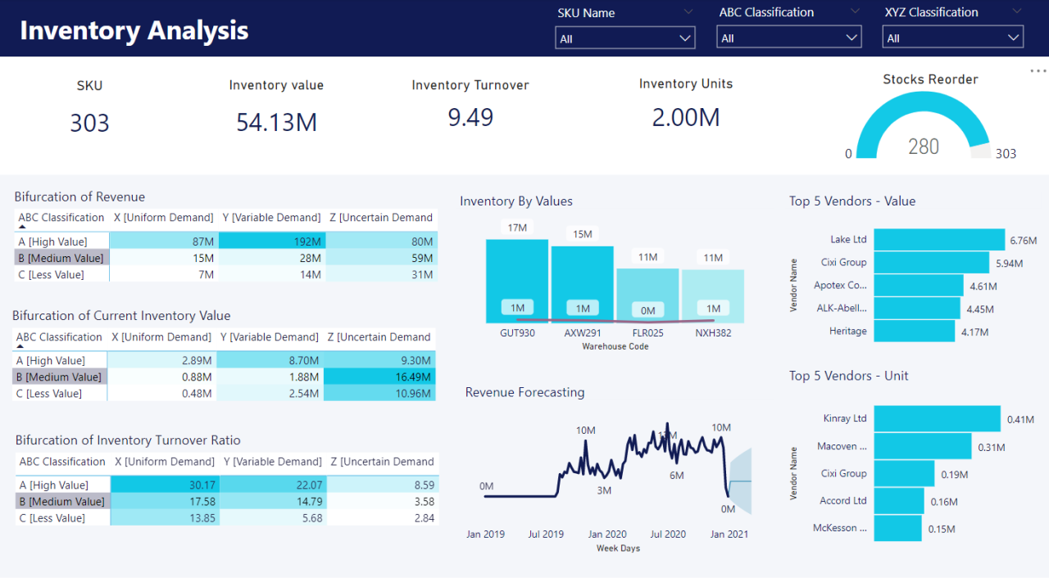

Sample Dashboard
Inventory Dashboard
Customized Dashboard Notice: This is a sample dashboard. Please create your own unique version instead of replicating it

Slide 9
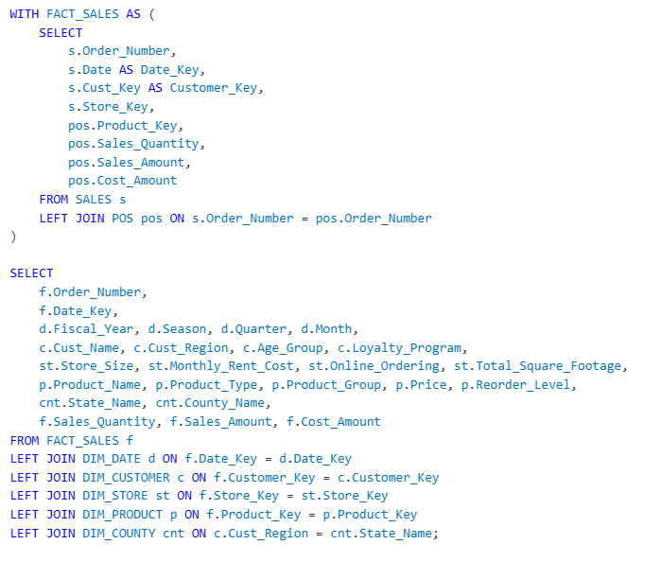

Data Model for Database
Inventory Data Model
CUSTOMER (Cust Key) → SALES (Cust Key)
SALES (Store Key) → STORE (Store Key, missing in STORE table)
SALES (Order Number) → POS (Order Number)
PRODUCT (Product Key) → INVENTORY ADJUSTED (Product Key)
PRODUCT (Product Key) → POS (Product Key)
COUNTIES (State Name) → CUSTOMER (Cust State)
CALENDAR (Date) → SALES (Date)

Slide 10





How Project Timeline Works
Date | Time | Task Description
20-04-2025 | 09 AM – 10 AM | Project Kick-off Meeting
27-04-2025 | 09 AM – 10 PM | Implementation of KPI’s using Excel
04-05-2025 | 09 AM – 10 AM | Implementation of KPI’s using Tableau/SQL/QA
11-05-2025 | 09 AM – 10 PM | Implementation of KPI’s using Power BI/SQL/QA
18-05-2025 | 09 AM – 10 PM | Final Presentation of the Project

Slide 11








KEY INSIGHTS
1-Power Bi Interview Questions
Link- https://medium.com/@mahendraa1188/50-real-time-power-bi-interview-question-3bde14068596
Interview Preparation
2-Scenario Based Power BI Interview Question
Link-https://medium.com/@mahendraa1188/scenario-based-power-bi-interview-question-c625877103ab
Follow the links and prepare for the interview. If you need any help or have additional questions, I am happy to assist you on your interview preparation journey
3-Best Practices for Writing a Data Analyst & Data Scientist Resume
Link-https://medium.com/@mahendraa1188/best-practices-for-writing-a-data-analyst-resume-c74fb72b87e8
4-Tableau Developer Interview Question
Link-https://medium.com/@mahendraa1188/tableau-developer-interview-question-47c0d0bc9d4d
5-Business Analyst Interview Question
Link-https://medium.com/@mahendraa1188/business-analyst-interview-question-ffdb61c1c887
6-SQL Interview Question For Data Analyst
Link-https://medium.com/@mahendraa1188/sql-interview-question-for-data-analyst-b49189f7f4b6
7- Naukri Profile Optimization Guide: Get More Job Calls in 2025
Link-https://medium.com/@mahendraa1188/naukri-profile-optimization-guide-get-more-job-calls-in-2025-232a39c10b3a
8- Data Warehousing Interview Questions
Link-https://medium.com/@mahendraa1188/data-warehousing-interview-questions-a963c320f6be

Slide 12


Always Stay in Touch
Coming together is a beginning, staying together is progress, and working together is success.
© 2025 Mahendra Singh. All rights reserved.

